Slide 1




Group No.: 107
Name: Ankit
Mentor: Dr. Gitanjali Chandwani
Roll No.: 101815169
DDoS Attack Detection in SDN using Entropy

Slide 2
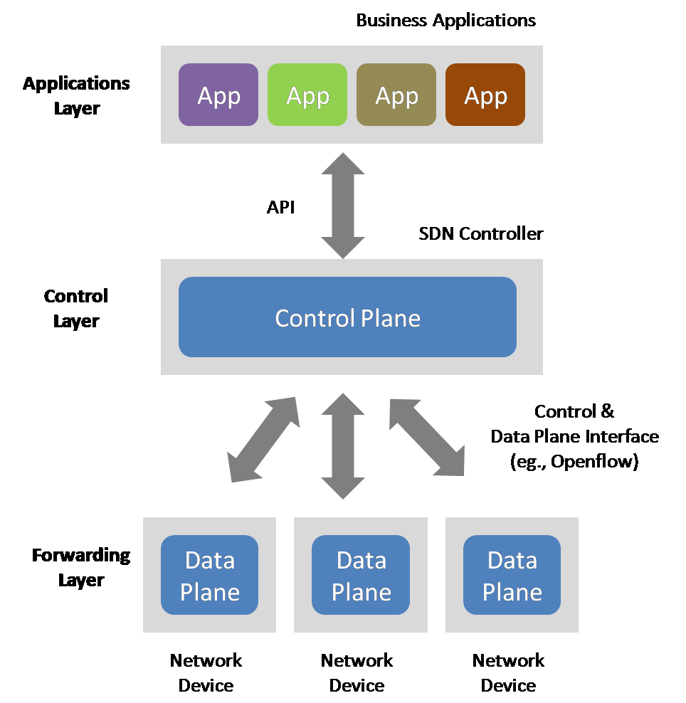
Introduction
SDN
Software Defined Networking is three layer architecture with central intelligence that we call as SDN Controller. By detaching the data plane from the control plane, the SDN architecture simplifies the job of web administrators by providing a programming interface for application development related to administration, safety, and dependability, and many other things. More access over the total network is provided by the centralized controller.

Slide 3
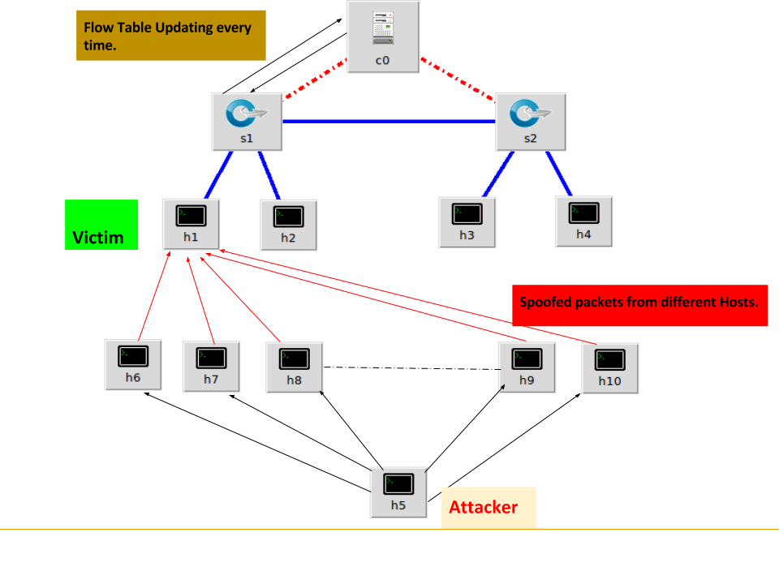
Introduction
DDoS
A distributed denial-of-service (DDoS) attack is a malicious attempt to disrupt the normal traffic of a targeted server, service or network by overwhelming the target or its surrounding infrastructure with a flood of Internet traffic.
Basically, large number of packets are forwarded to a network device for stopping the service, decreasing the performance and spoofed packets sent to controller.

Slide 4

Objectives
The main objectives are:
Analysing the behaviour of DDoS attacks on SDN environments.
Analysing the network by means of sample entropy.
When a DDoS threat happens, determine the weakest link in the SDN.
Implementing a mechanism for early detection of DDoS Attacks in SDN.

Slide 5

Detection of DDoS Attack
The detection of DDoS must be early.
The term early is subjected to tolerance level and traffic being handled by the controller
Results in controlling flooding of malicious packets significantly.
The early detection mechanism must be of light weight and should have high response.
The high response time helps the controller in regaining the control during DDoS.
Detecting the ENTROPY variation in the destination address

Slide 6

Our Solution
Sample entropy, a general method for DDoS detection in SDN, is conducted by collecting the flow statistics or traffic features from the switches, and calculating the entropy measure randomness in the packets that are coming to a network.
The higher the randomness, the higher is the entropy and vice versa. By setting a threshold, if the entropy passes it or below it, depending on the scheme, an attack is detected.

Slide 7
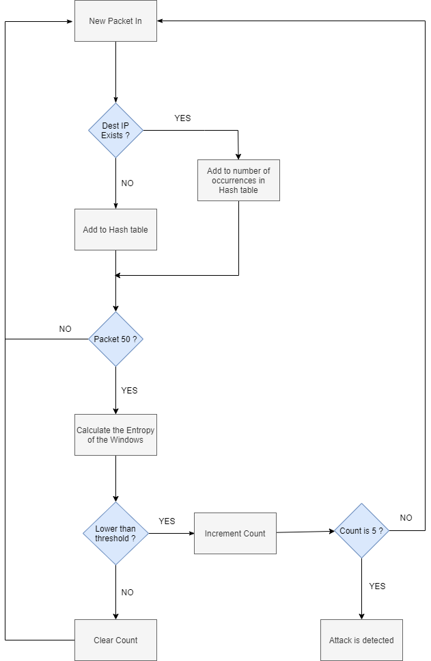
Flowchart
Each 50 Packet-In signals are parsed for the destination IP address in Algorithm, and thus the entropy of the list is calculated. After then, the computed entropy would be checked to a threshold. It is deemed an attack if the computed entropy is below the threshold and lasts for at least five successive entropy cycles. Detection inside Five entropy cycles is 250 packets in the intrusion, providing the network with an early warning of an assault. We tested with values ranging from one to 5 successive cycles, with five yielding the lowest false negative and positive rates for timely identification.

Slide 8



Technologies Used
Mininet
Network Emulator
Rapid prototyping of Software Defined Networks
Python API for network construction, exploration and experimentation
POX Controller
Python based controller
Quick and lightweight controller
Used for research, experimentation, and demonstrations.
Scapy
Python application packet generation
Decode packet, transmit them over the network, collect them, and compare requests and responses.

Slide 9
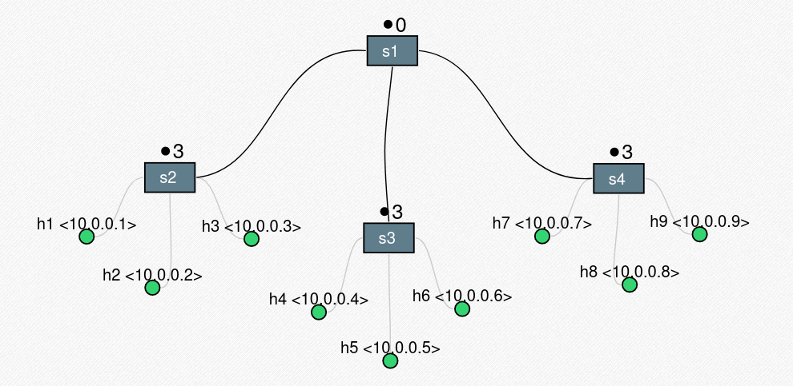
Topology

Slide 10
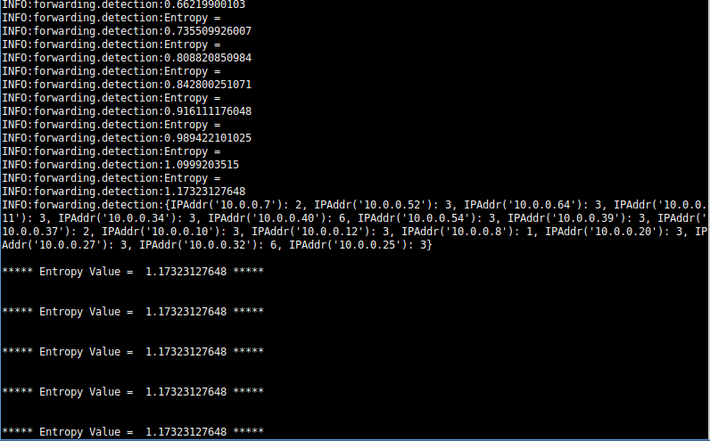
Emulation
Entropy before Attack

Slide 11
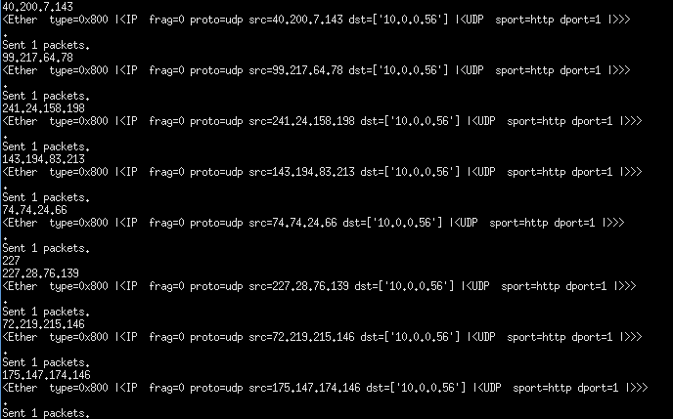
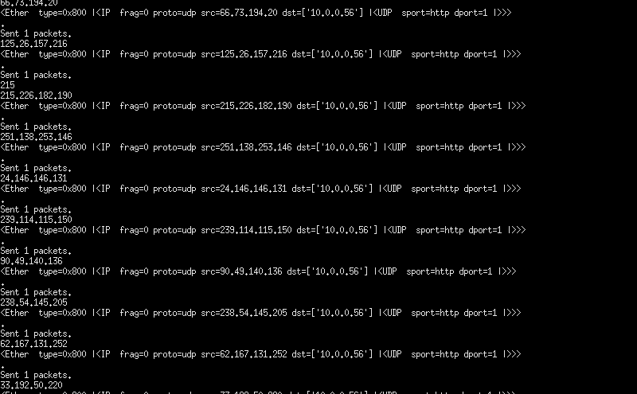
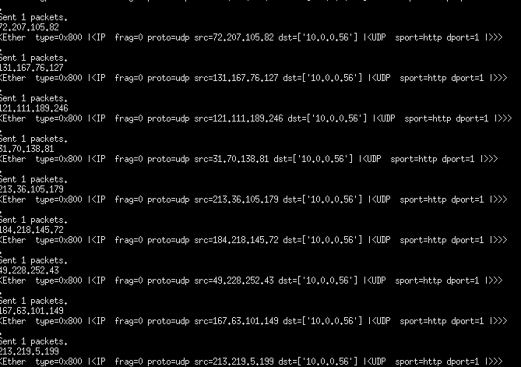
Emulation
Launching traffic in netwok

Slide 12
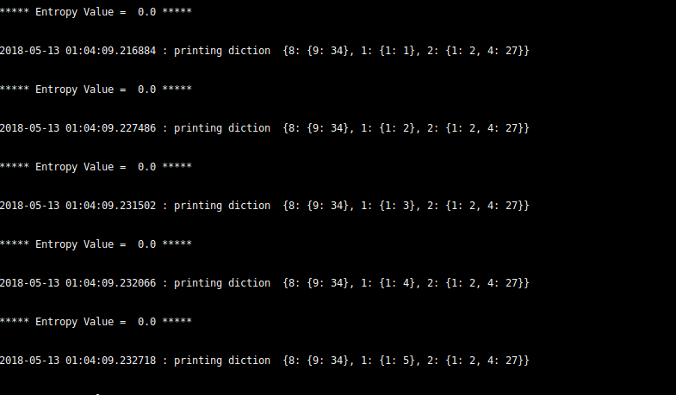
Emulation
Entropy after Attack

Slide 13
Conclusion
We have successfully implemented sample entropy method to detect DDoS attacks. This solution is not only efficient in detection, it has minimal code addition to the controller program and does not increase CPU load in either normal or attack condition.
We worked on Detection of DDoS Attacks in one controller network, next we can work on multi-controller SDN structure to detect Distributed Denial-of-Service Attacks. Having addressed the problem of detection of attack on the network, Mitigation of the Distributed Denial-of-Service attack in the SDN environment will be the next task in our research work.
Thank You

